Slide 1
Information Security Foundation
Information Security

Slide 2
Information Security Foundation
What is Information Security?
Information Security Services
Information Security Terminology
Information Security Challenges
Security Functional Requirements
Layers in a Defense-in-Depth Strategy
Fundamental Security Design Principles
Information Security Mechanisms

Slide 3
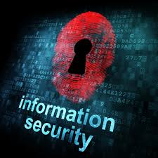
What is Information Security?
Information security is concerned with protecting information from unauthorized access.

Slide 4
What is Information Security?
According to National Institute of Standards and Technology (NIST) and the National Information Assurance (NIA) Glossary,
“Information security is the protection of information and information systems from unauthorized access, use, disclosure, disruption, modification, or destruction in order to provide confidentiality, integrity, and availability."
Notes:
Disclosure: Expose
Disruption: Disturbance
Afforded: Provided, Presented

Slide 5
What is Information Security?
Security = Sustain desirable properties under intelligent adversaries
  An adversary is a subject who tries to gain unauthorized access
Desirable properties
  Understand what properties are needed.
Intelligent adversaries
  Needs to understand/model adversaries
Notes:
An adversary is a subject who tries to gain unauthorized access

Slide 6
Information Security Services
Confidentiality:
  Information only accessible to authorized entities
  Threat: Non-authorized access to data or traffic analysis
Integrity:
  Only authorized entities can modify the information
  Threat: Modification of data or introduction of false data
Availability:
  Guarantees the availability of the information for authorized entities whenever required
  Threat: Elimination of data or resources
Notes:
Elimination: Removal

Slide 7
Information Security Services
Authentication:
  Authentication is the process of validating the identity of a registered user before allowing access to the protected resource
  Threat: Third-party masquerading as sender / receiver
Non-repudiation:
  Guarantees that sender and receiver of a message can’t deny its transmission
  Threat: Deny having transmitted or received certain data
Access Control:
  Guarantees controlled access to information and systems to authorized entities
  Threat: Access of confidential data to non authorized entities
Notes:
Masquerade attack to disguise as someone else and gain unauthorized access to victims' systems or organizations' network.
Repudiation: denial of the truth or validity of something
Non-repudiation is the assurance that someone cannot deny the validity of something. ... In this context, non-repudiation refers to the ability to ensure that a party to a contract or a communication must accept the authenticity of their signature on a document or the sending of a message.

Slide 8
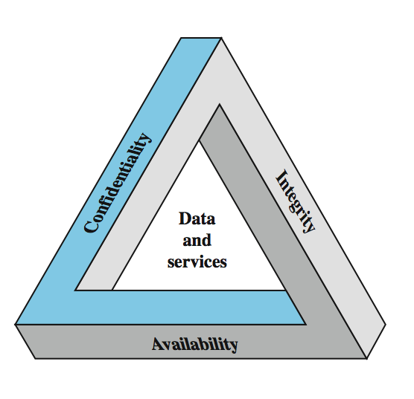
Key Security Concepts

Slide 9
Information Security Terminology
An adversary is a subject who tries to gain unauthorized access
A threat is any potential danger to information life cycle
A risk is a loss due to an adversary gaining unauthorized access
A vulnerability is a flaw (bug), which enables a threat to allow the adversary for unauthorized access
Notes:
Threat: Any potential danger to information life cycle
Flaw :Bug, defect, fault, breach, hole, gap
Cyber threats also refer to the possibility of a successful cyber attack that aims to gain unauthorized access, damage, disrupt, or steal an information technology asset, computer network, intellectual property or any other form of sensitive data.
Employing: Operating

Slide 10
Information Security Challenges
Defense is almost always harder than attack.
Information security is more difficult than physical security?
  Adversaries can come from anywhere
  Computers enable large-scale automation
  Adversaries can be difficult to identify
  Adversaries can be difficult to punish
  Possible payoff can be much higher
Notes:
Payoff: payment given to stop someone causing you trouble

Slide 11
FIPS-200 Security Functional Requirements
(Federal Information Processing Standards)
Technical Measures
  Access control; identification & authentication; system & communication protection; system & information integrity
Management Controls and Procedures
  Awareness & training; audit & accountability; certification, accreditation & security assessments; incidental planning; maintenance; physical & environmental protection; planning; personnel security; risk assessment; systems & services acquisition
Extending Technical and Management
  Configuration management; incident response; media protection, contingency planning
Notes:
An auditor reviewing a company's financial statement is responsible and legally liable for any misstatements or instances of fraud. ... As an example, an accountant is accountable for the integrity and accuracy of the financial statements, even if errors were not made by them.
FIPS(Federal Information Processing Standards)
Acquisition: purchase
Overlapping: Extend over and cover a part

Slide 12
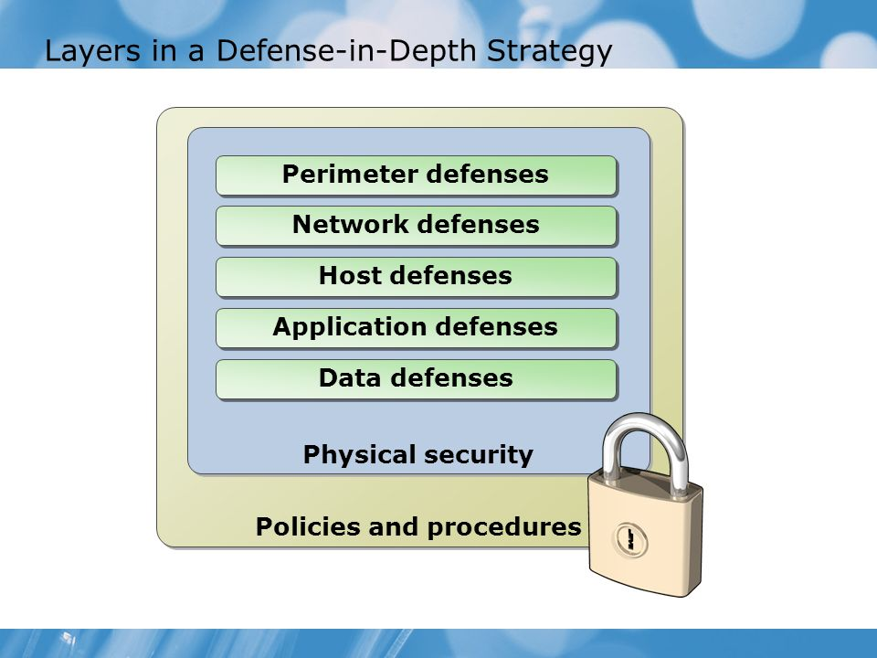
Layers in a Defense-in-Depth Strategy

Slide 13
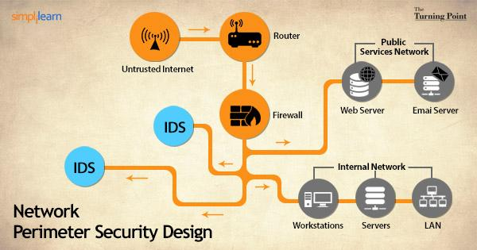
Layers in a Defense-in-Depth Strategy

